Slide 1

RESEARCH CENTRE IMARAT
DIRECTORATE OF EMBEDDED AND ARTIFICIAL INTELLIGENCE SYSTEMS
Project presentation
on
UAV Swarm Formation & Path Planning
RCI Guide: Archana Ma’am & Sai Charan Sir
Anup Kumar Tiwari →College Guide: Dr. Soumya S.
Akshaan Gupta →College Guide: Dr. MM Kuber
Asuwin.J →College Guide: Dr. MM Kuber

Slide 2

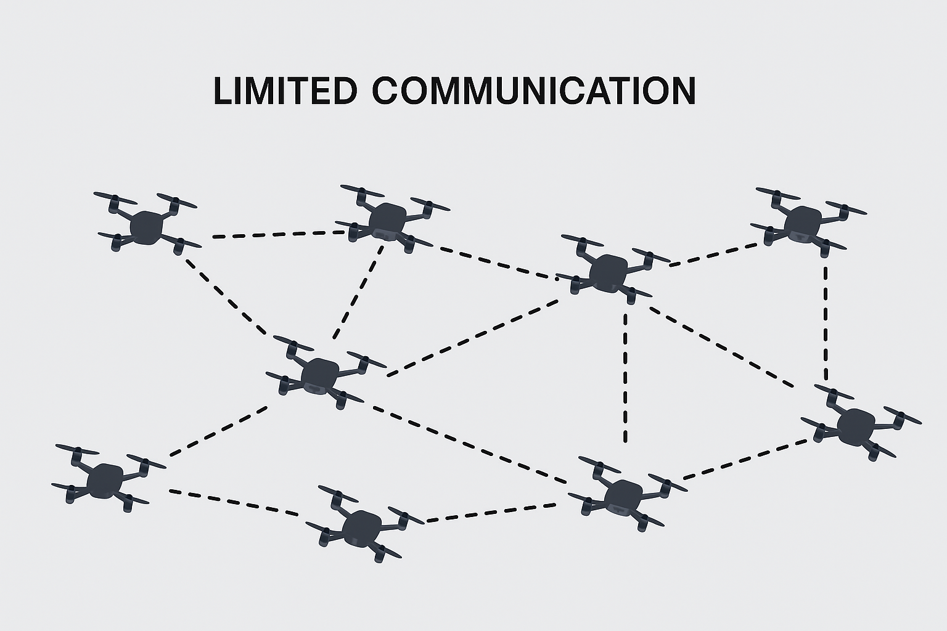
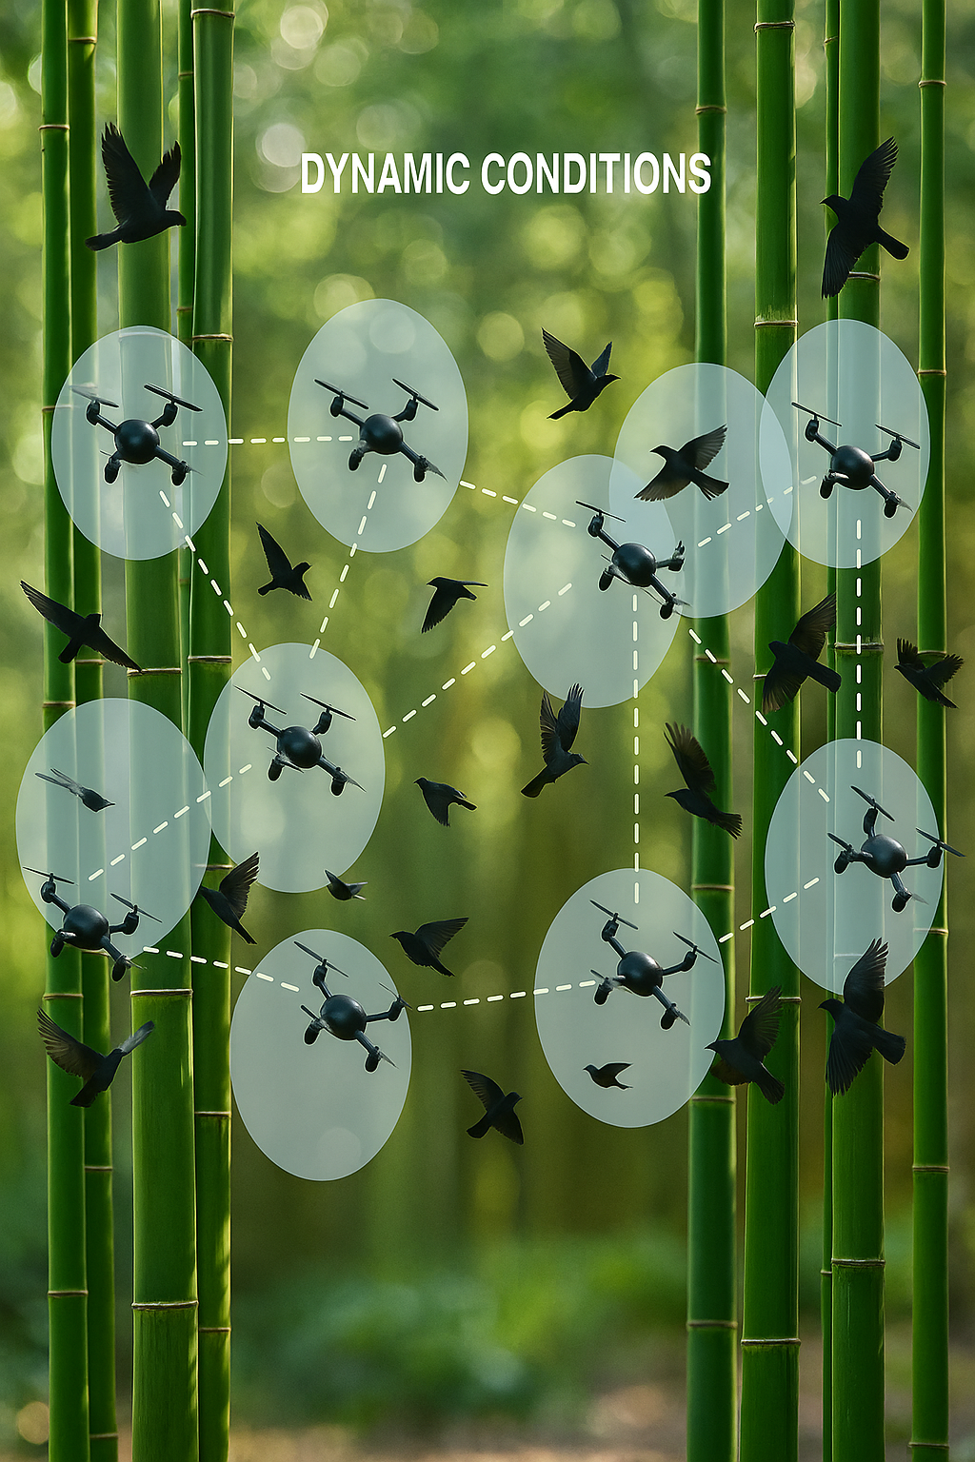
Problem Statement
UAV swarm in complex Environment :
Dense Obstacles Limited communication range Dynamic Conditions
Need for robustness, scalable and autonomous coordination.

Slide 3
Objectives
Simulation in Unreal Engine using Colosseum.
Decentralized Control:
Formation Control
Path planning
Obstacle Avoidance
Task allocation
Effective navigation

Slide 4
Literature Survey
 | Name | Authors | Year of Publication | Comments
1. | Formation Control for Multiple Unmanned Aerial Vehicles in Constrained Space using Modified Artificial Potential Field. | Hang Yin, Lea L. Cam, Utpal Roy | 2017 | Proposed artificial potential field for formation control.
2. | A Proximal Policy Optimization Method in UAV swarm formation Control | Ning Yu, Feng Juan, Hongwei Zhao | 2024 | Used Reinforcement Learning for adaptive swarm behaviour.
3. | Swarm of Micro Flying Robots in the Wild | Xin Zhou, Xiangyong Wen, Zhepei Wang | 2022 | Demonstrated real-world UAV swarm navigation in forests using decentralized control in a complex environment.

Slide 5
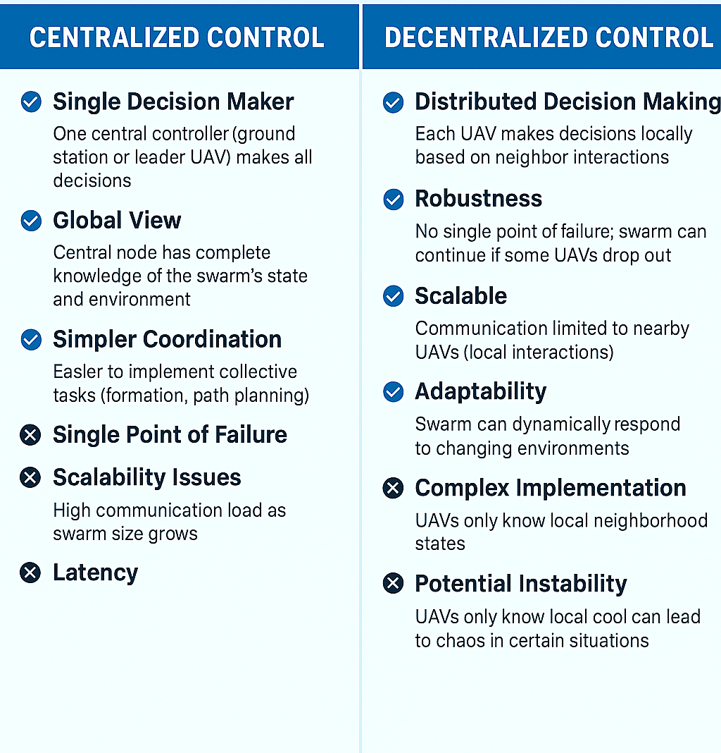
UAV Swarm Control

Slide 6
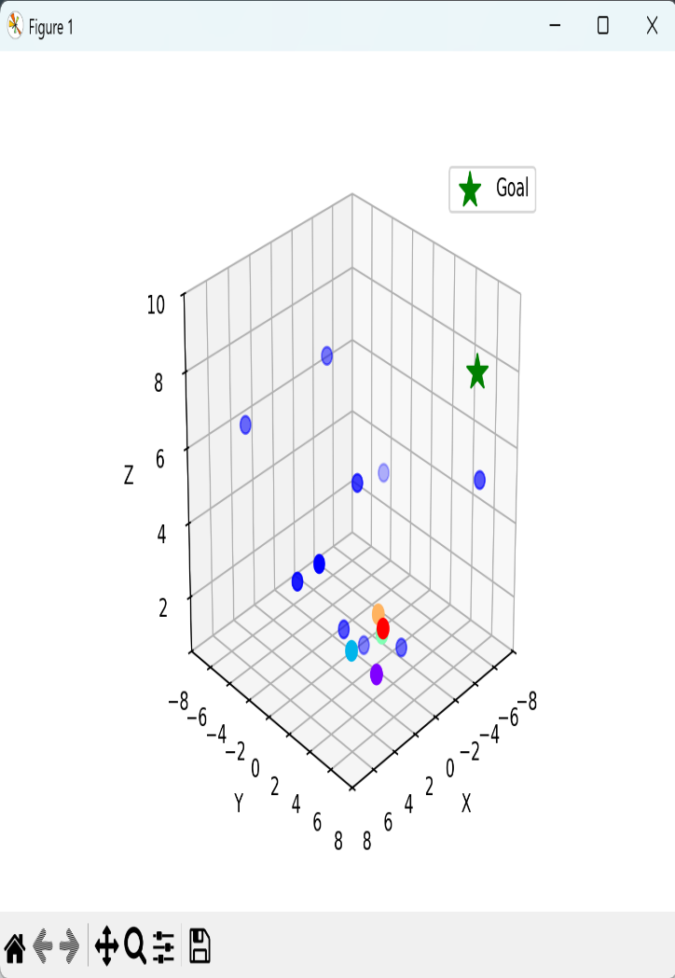
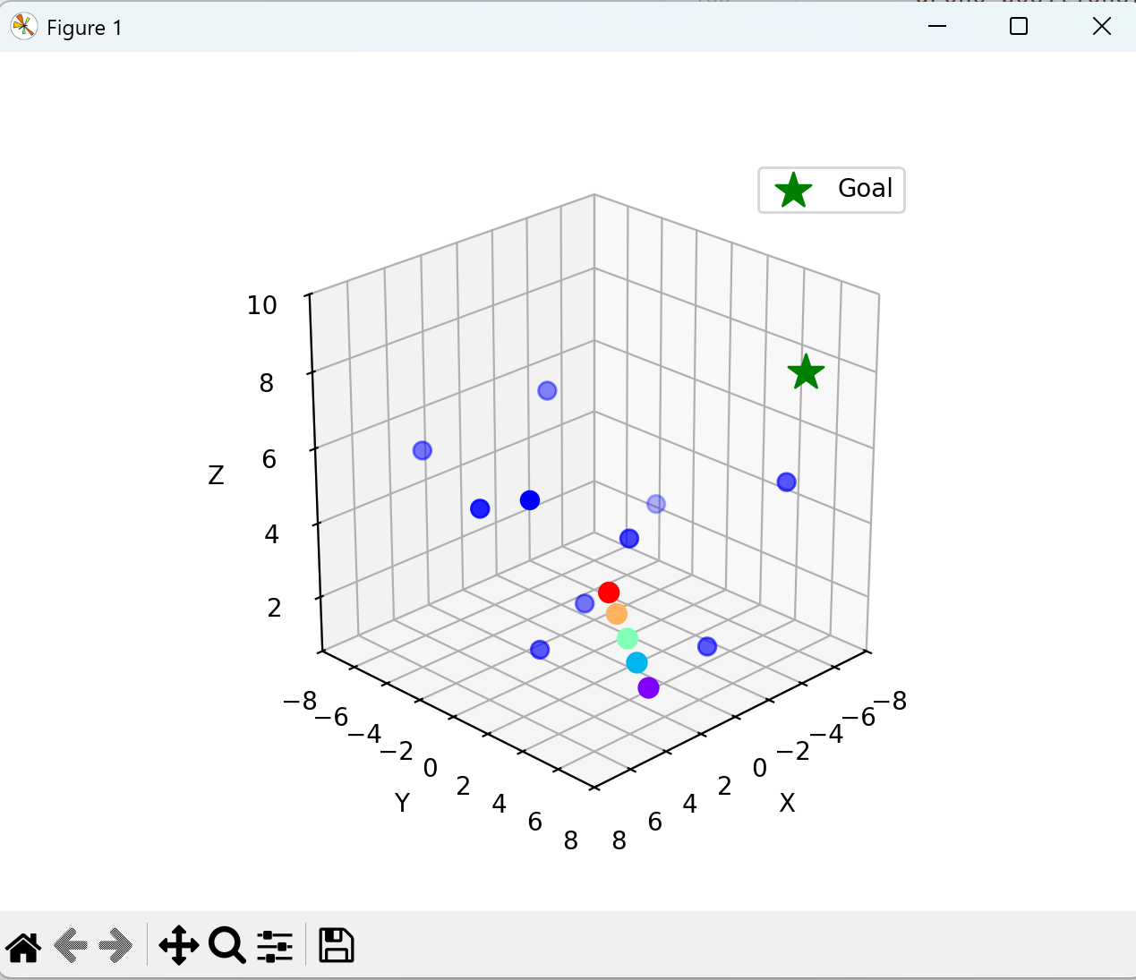
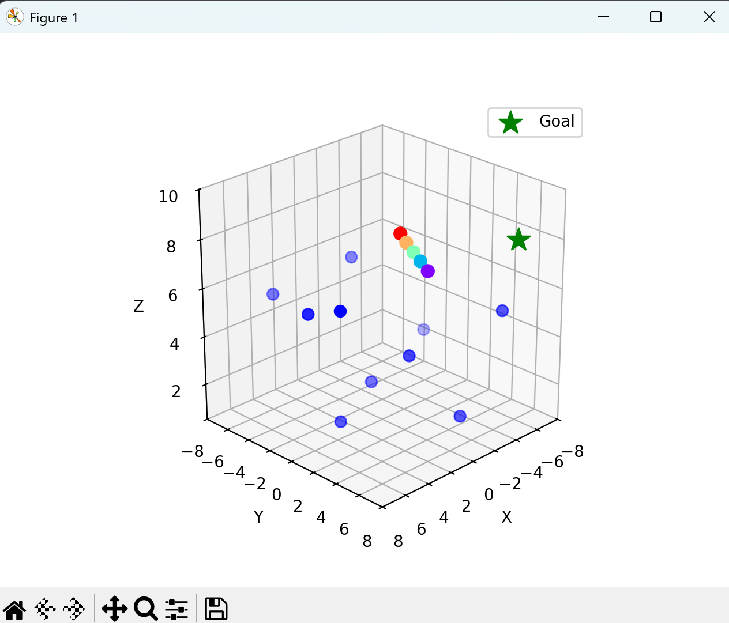
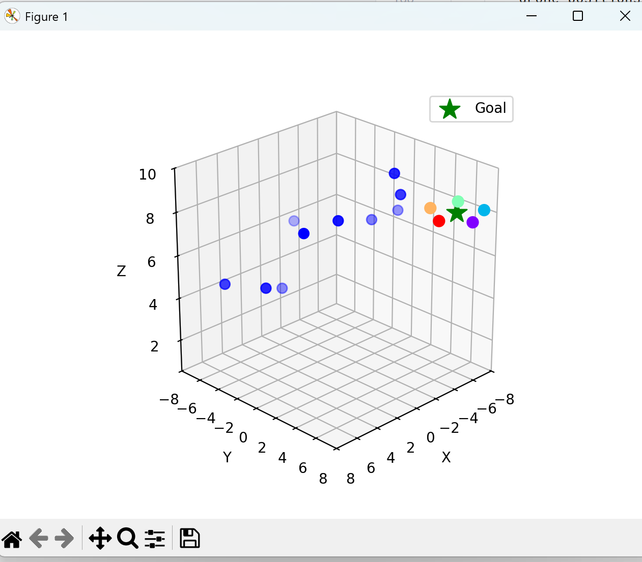
Work Done so Far → Centralized Control

Slide 7
Flow Chart → Centralized Control
Start
|
v
[Phase 0: Line Formation]
- Compute centroid C
- Align drones on perpendicular line
|
v
[Phase 1: Move Line to Goal]
- Move along goal dir
- Apply obstacle repulsion
|
v
[Phase 2: Circle Capture]
- Assign circle slots
- Move drones to slots (snap when close)
|
v
[Phase 3: Circle Rotation]
- Rotate circle around goal
|
v
End

Slide 8
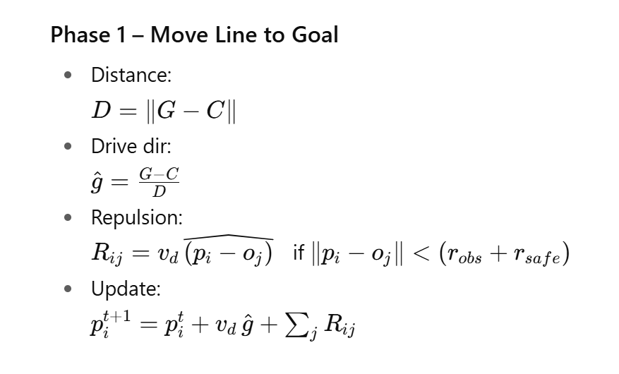
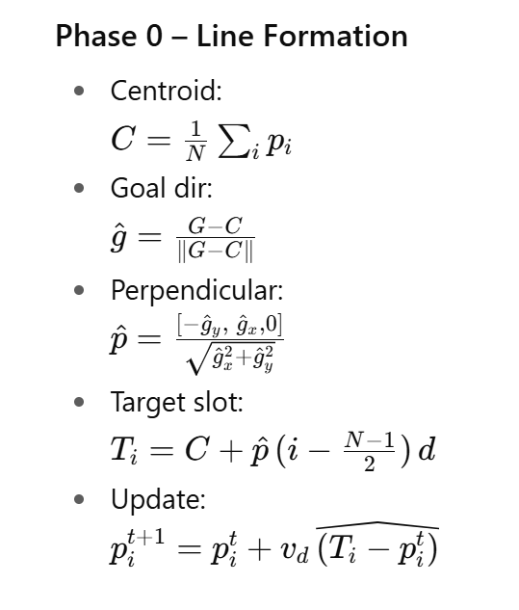
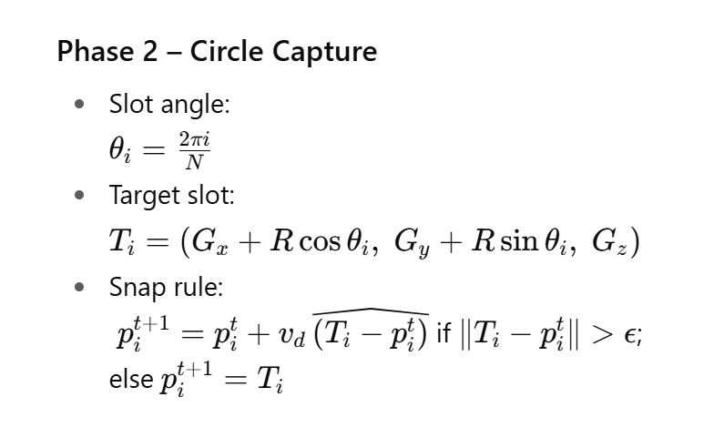
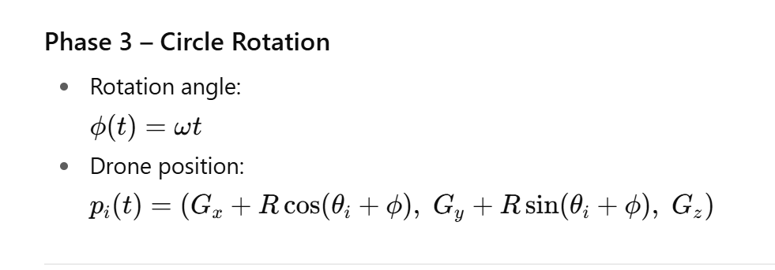
Phase-wise Equations → Centralized Control

Slide 9
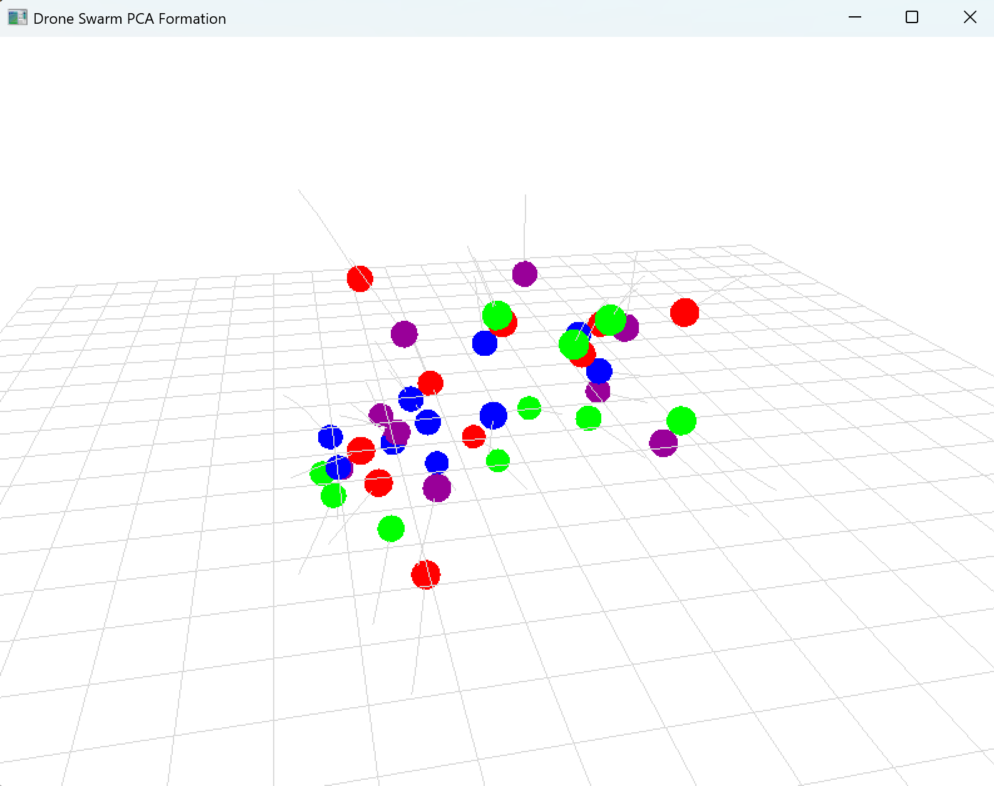
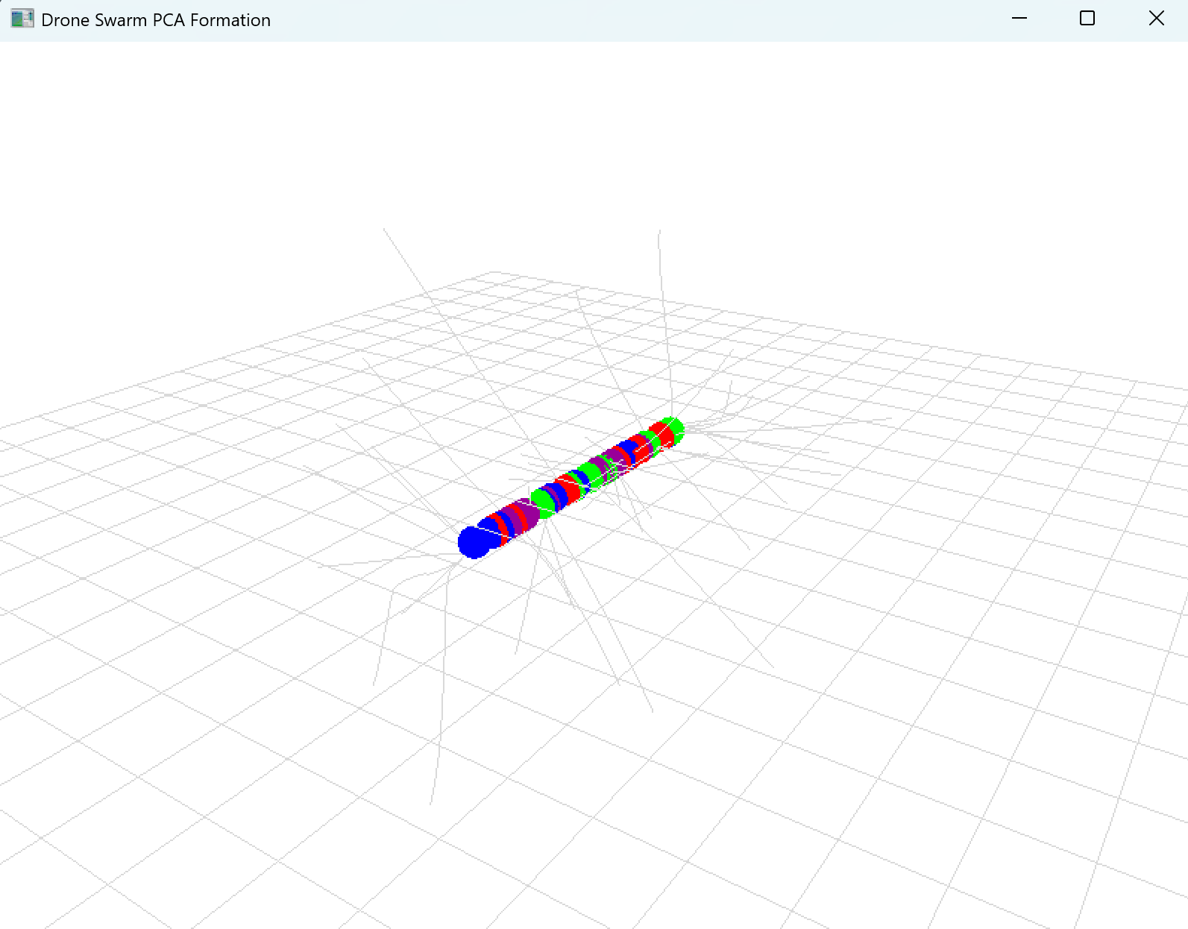
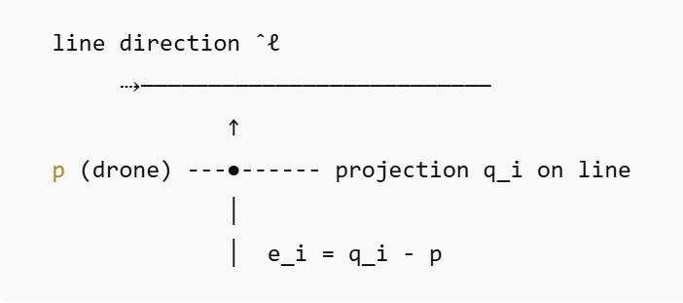
Work Done so Far → Straight line formation using Decentralized Control
Flow Chart

Slide 10
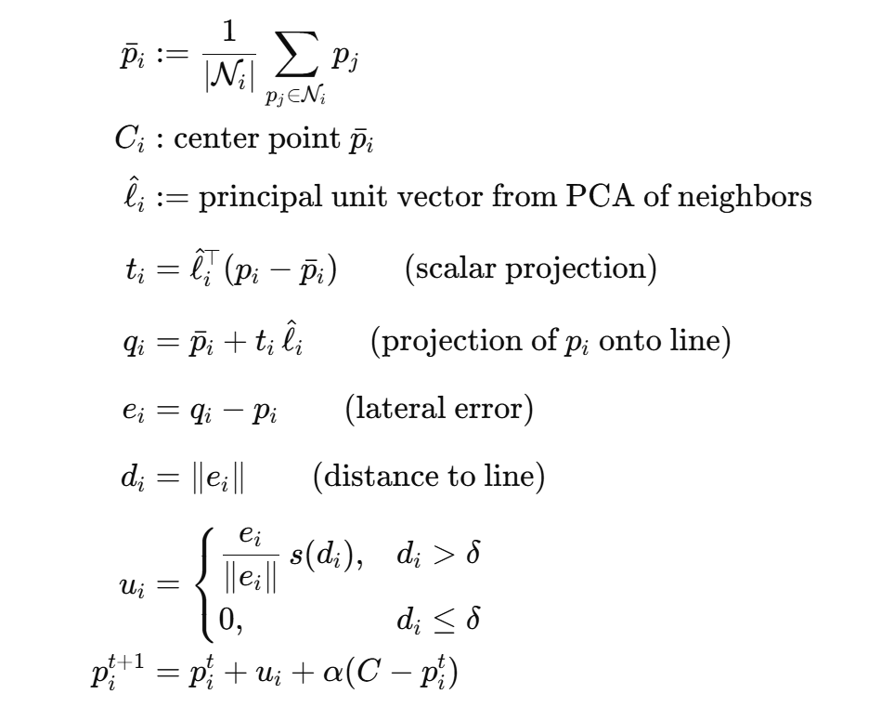
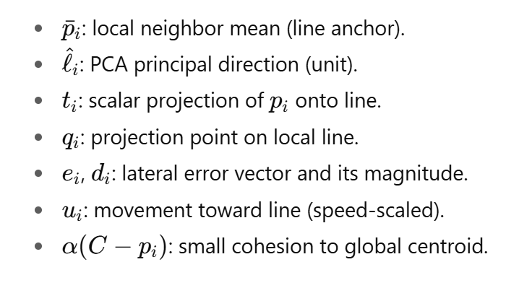
Equations used → Decentralized Control

Slide 11
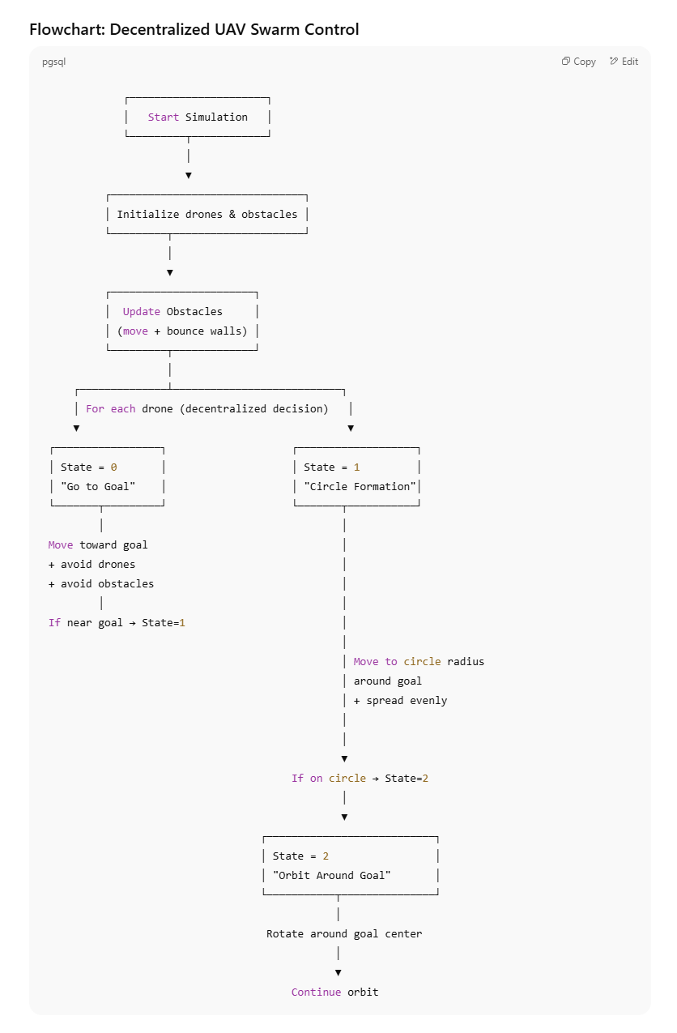
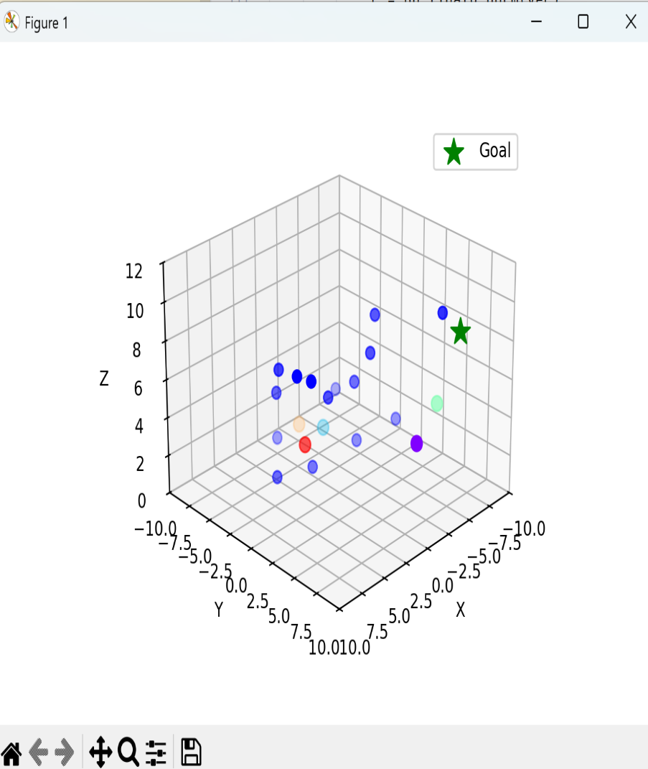
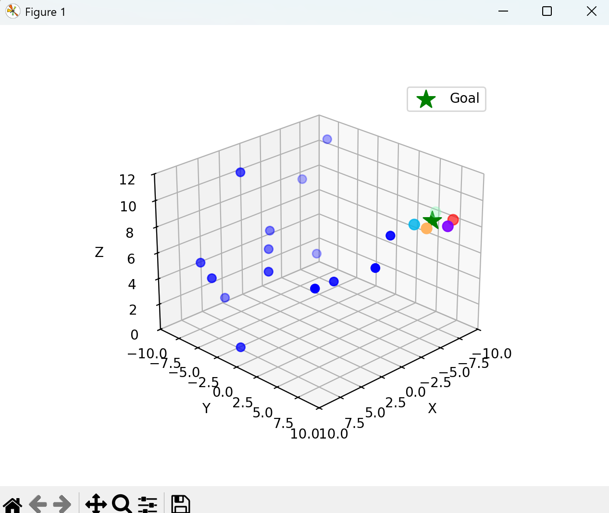
Work Done so Far → Circle form. & rotation, using Decentralized Control

Slide 12
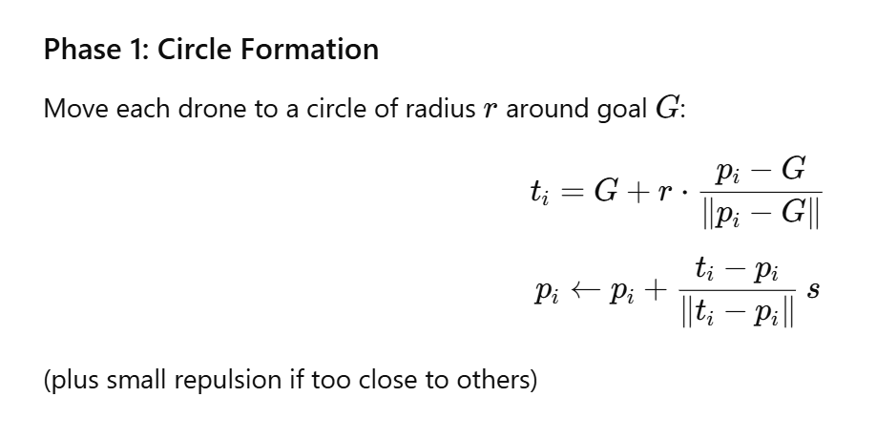
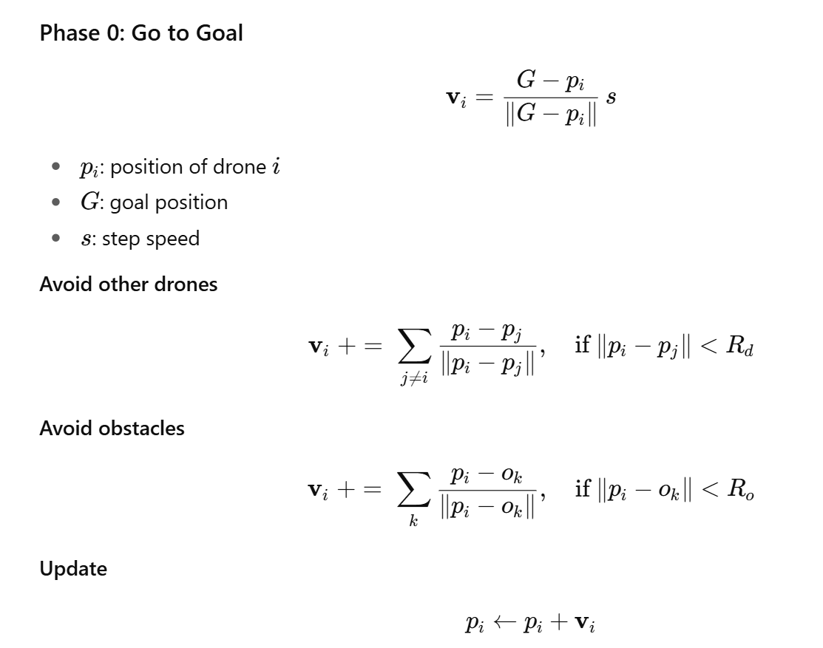
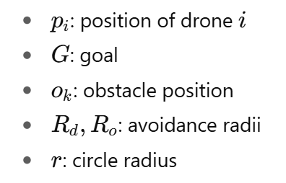
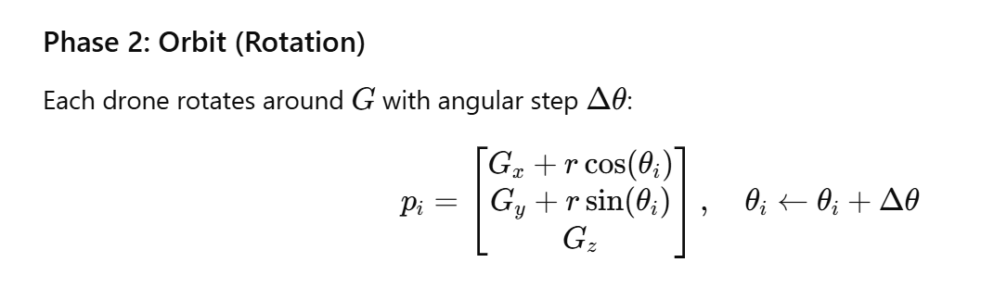
Equations used

Slide 13
Future Work
Decentralized Control – Develop fully distributed decision-making without central authority.
Robustness – Ensure resilience against failures, noise, and dynamic environments.
Scalability – Extend framework to handle large-scale swarms with minimal computation.
Autonomous Coordination – Enable self-organization for formation, path planning, and task allocation.

Slide 14
Applications
Search & Rescue Operations
Rapid area coverage
Victim localization in disaster zones
Environment Mapping
3D terrain and infrastructure mapping
Real-time data collection over large regions
Defence & Surveillance
Border monitoring and patrolling
Threat detection with persistent coverage

Slide 15
Thank You!

